Slide 1
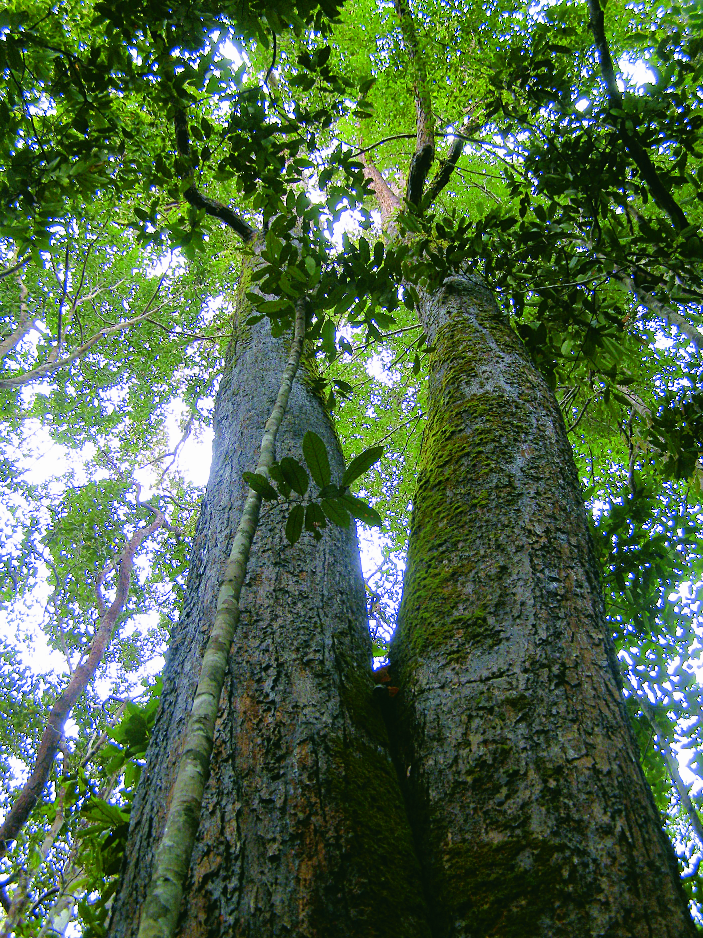



Progress of APFNet/2013/PP/05
Community Based Sustainable Forest Management of Sungai Medihit Watershed, Sarawak, MALAYSIA
LI Qiang
ITTO Secretariat
The 2nd meeting of the APFNet Council
Siem Reap, Cambodia
INTERNATIONAL TROPICAL TIMBER ORGANIZATION (ITTO)

Slide 2
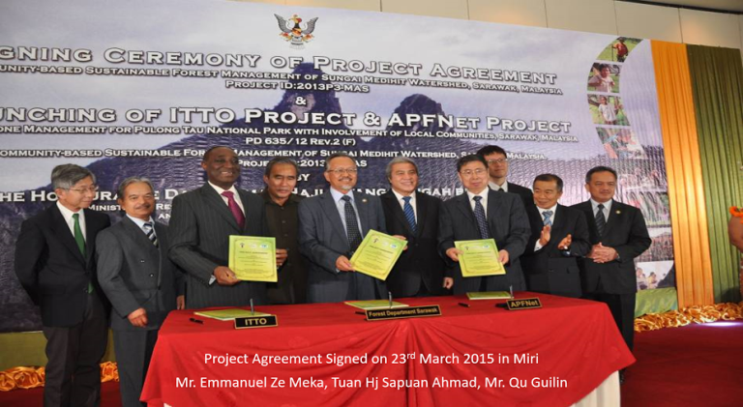
KEY MILESTONES OF APFNet-ITTO-SARAWAK FD SUNGAI MEDIHIT WATERSHED PARTNERSHIP
In 2008, ITTO funded Pre-Project PPD135/07 Rev,1(F): Community-Based Forest Management of Sungai Medihit Watershed, SARAWAK
In 2012, ITTO Secretariat forwarded the document [PD563/09 Rev.4(F): Community-Based Forest Management of Sungai Medihit Watershed, SARAWAK] to APFNet Secretariat
In early April 2013, the honourable Executive Director of APFNet, Prof. Qu Guilin led a delegation to SARAWAK
In 2014, the Project Document was finalised by APFNet, ITTO and Executing Agency
THE TRIPARTITE AGREEMENT OF THE PROJECT WAS SIGNED ON 23 MARCH 2015 AT MEGA HOTEL, MIRI, SARAWAK
Borneo Post Online March 24, 2015
http://www.theborneopost.com/2015/03/24/awg-tengah-state-welcomes-ngos-help-to-protect-its-forests/

Slide 3
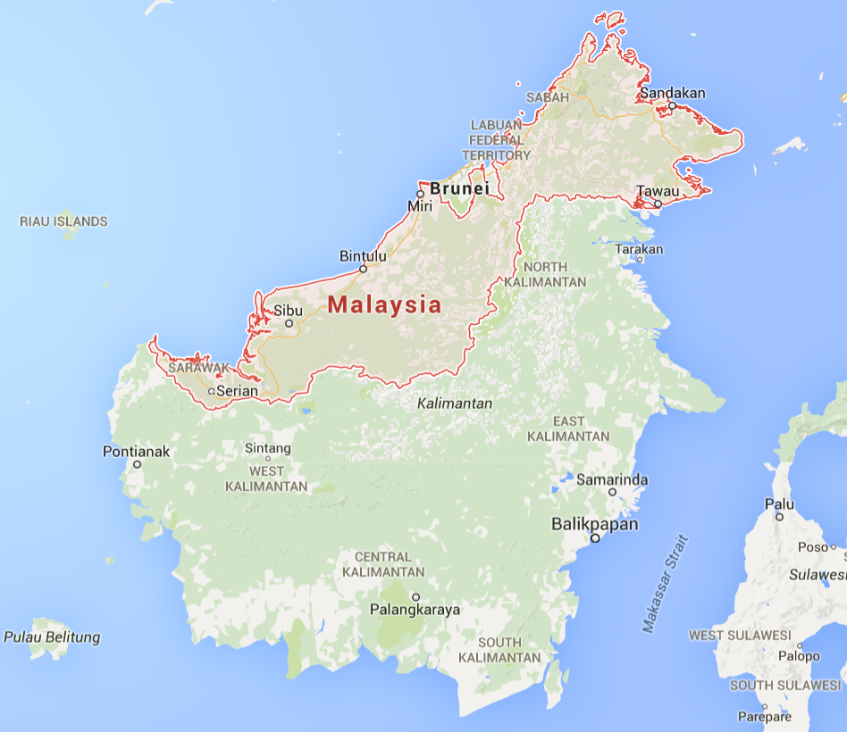
MAP OF SARAWAK, MALAYSIA
Project Location | Sungai Medihit Watershed, Sarawak, MALAYSIA
Project Sites | Long Napir and Kampung Bahagia
Target Communities | Kelabit at Long Napir and Penan at Kampung Bahagia
Sabah, Malaysia
Long Napir
Project Site
Sarawak, Malaysia

Slide 4
Long Napir
Villagers are of old folks and depends on farming, forest produce and hunting for livelihood. Electricity power is available from 6 – 10pm
PROJECT SITES
LONG NAPIR &
KAMPUNG BAHAGIA
Kampung Bahagia
Villagers are living the traditional way of life, depending heavily on hunting, farming and jungle produce. No electricity, only small generator at a few houses

Slide 5
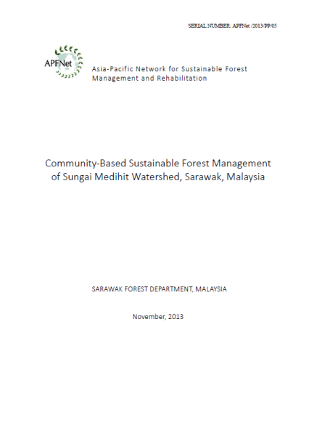
PROJECT GOAL AND SPECIFIC OBJECTIVES
The goal is to promote Sustainable Forest Management in Sungai Medihit Watershed through building the capacity of the local community, demonstrating innovative operational models and establishing new governance mechanism on community development
The project aims to
To promote Sustainable Forest Management through the setting up Forest Management Plans, applying innovative Forest Management Techniques and establishing Forest Management Mechanism
To enhance the capacity of communities on Sustainable Forest Management and livelihood development
To improve the living conditions by upgrading the community service infrastructure

Slide 6
OUTPUT 1: IMPROVEMENT IN COMMUNITY FOREST MANAGEMENT
Activity 1.1 Baseline Survey on Resources and Socio-economic Development
A resource survey was successfully carried out deep in the forest by a team of field assistants led by the Project consultant
A socio-economic survey was successfully carried out by Project consultants with assistance from university students as field assistants
Achievement

Slide 7
OUTPUT 1: IMPROVEMENT IN COMMUNITY FOREST MANAGEMENT
Activity 1.1 Baseline Survey on Resources and Socio-economic Development
The team gathered data on forest resources and community socio-economic circumstances. The consultant has developed a preliminary Community Forest Management Plan
The implementation of Activiti 1.1 acts as a precursor to the successful implementation of other activity in achieving the goal of improvement in Community Forest Management
Impacts

Slide 8
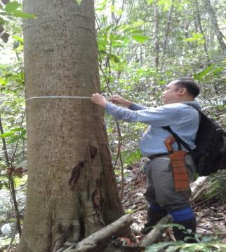
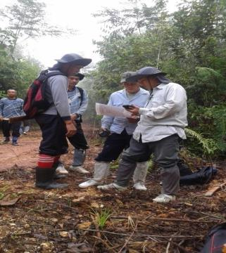
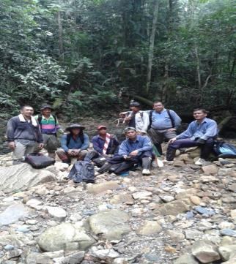
OUTPUT 1: IMPROVEMENT IN COMMUNITY FOREST MANAGEMENT
Activity 1.1 Baseline Survey on Resources and Socio-economic Development
Forest Resource Assessment Activities Pictures

Slide 9
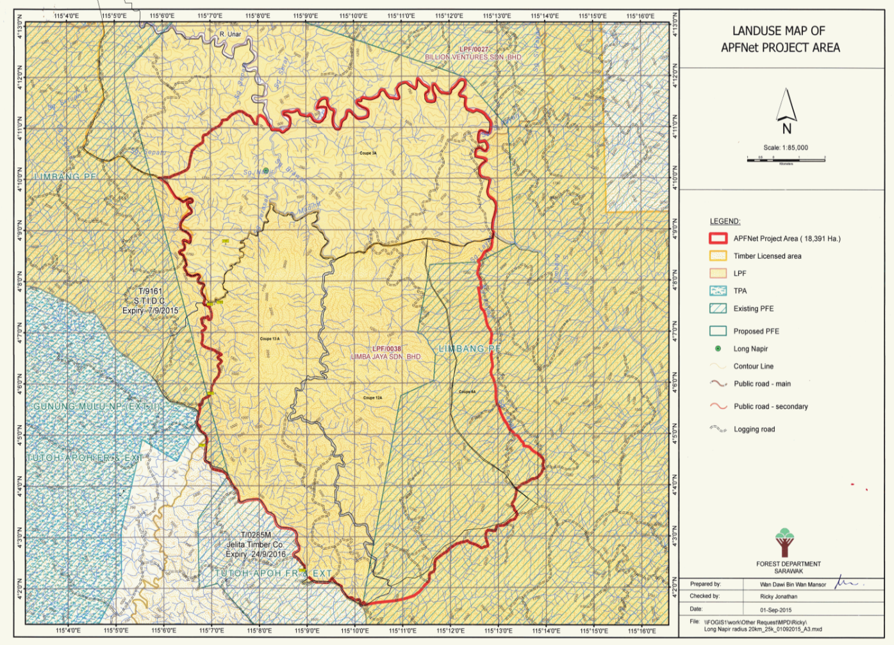
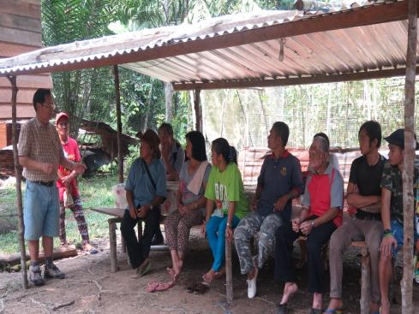
Community Forest Management Planning
In Sarawak, the success of community forestry activities was seen as dependent on
(i) the community possessing on legal rights to forest produce and/or security of land tenure and
(ii) initiative taken by the community (rather than imposed from outside)
Discussions of the project with the two indigenous communities include:
limiting extraction of important timber species used for house and boat construction;
felling only mature trees (e.g. ramin for planks and kapur for the body of a boat);
nurturing seedlings, saplings and immature trees and leaving them to mature.

Slide 10
Community Forest Management Planning
In Sarawak, the success of community forestry activities was seen as dependent on
(i) the community possessing on legal rights to forest produce and/or security of land tenure and
(ii) initiative taken by the community (rather than imposed from outside)
Discussions of the project with the two indigenous communities include:
limiting extraction of important timber species used for house and boat construction;
felling only mature trees (e.g. ramin for planks and kapur for the body of a boat);
nurturing seedlings, saplings and immature trees and leaving them to mature.

Slide 11
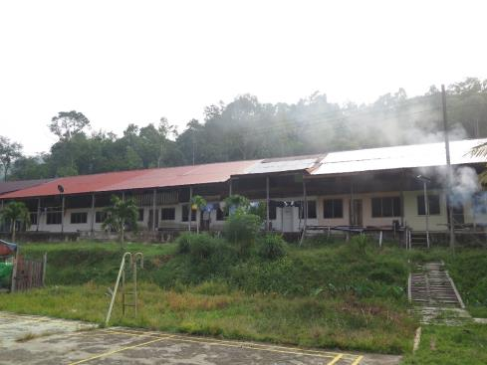
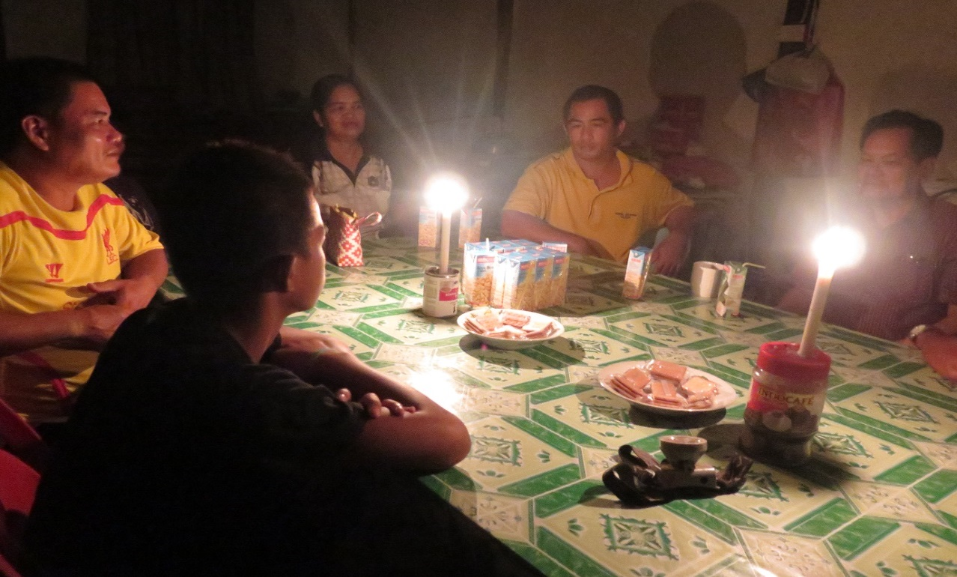
Traditional Longhouse at Long Napir
Kelabit’s longhouse at
Long Napir
Village meeting consultant at Long Napir until late at night without electricity

Slide 12
OUTREACH PLANS OF APFNET-ITTO-SARAWAK FD
SUNGAI MEDIHIT WATERSHED PARTNERSHIP
Several photos of Project activities have been uploaded to https://www.flickr.com/photos/apfnet/
These are photos taken at the Project site that shows the progress of the Project Output Activities
A successful Project briefing with the Sarawak State Secretary department and the State Planning Unit was held on 28 April 2016
Mr Shahbudin Bin Hj Sabki, Assisstant Director of Forest was also present in the Project briefing together with the Project Manager, Mr Morris Kapong and Senior Executive Forestor Mr Suliman Bin Jemahari

Slide 13
OUTPUT 1: IMPROVEMENT IN COMMUNITY FOREST MANAGEMENT
Activity 1.2 Community Forest Management Planning
Successful combined village meeting with 70% attendance of villagers
A timber resource survey was successfully carried out with the help of the local community
Work on participatory natural resources mapping started in forest areas far from the Project Village
Achievement

Slide 14
OUTPUT 1: IMPROVEMENT IN COMMUNITY FOREST MANAGEMENT
Activity 1.2 Community Forest Management Planning
Increase awareness of the importance of Sustainable Forest Management among the targeted communities
The data on timber resources and land mapping will lead to better land management and training for the community on nursery techniques for selected timber species to be raised and planted for future generations
Impacts

Slide 15
OUTPUT 1: IMPROVEMENT IN COMMUNITY FOREST MANAGEMENT
Activity 1.3 Demonstrate Sustainable Community Forest Management Practice
Completion of summarizing traditional models for protection and sustainable use of forest resources through interviews and field survey with help from local community
Identification of potential forest land to be reserved for Kelabit and Penan community
Create a complete list of tree and NTFPs species having economic value to the Kelabit and Penan communities and worth planting
Achievement

Slide 16
OUTPUT 1: IMPROVEMENT IN COMMUNITY FOREST MANAGEMENT
Activity 1.3 Demonstrate Sustainable Community Forest Management Practice
Data obtained will assist Project consultant in establishing a demonstration site for High Protection Value Forest and a nursery of important species such as Gaharu, Sekaliew, fruit trees and timber trees
A better understanding of the local community traditional model of forest resource usage prior to introduction of new method of Sustainable Community Forest Management
Impacts

Slide 17
OUTPUT 1: IMPROVEMENT IN COMMUNITY FOREST MANAGEMENT
Activity 1.4 Establish the Participatory Community Forest Management Mechanism
The consultant is deferring his field work for the time being due to the urgency to carry out resources survey (forest inventory) under Activity 1.1
Status

Slide 18
OUTPUT 2: CAPACITY OF THE COMMUNITY ON DEVELOPMENT ENHANCED
Activity 2.1 Alternative Livelihood Activities
A successful initiation of four (4) alternative livelihood activities
Identification and establishment of Tagang System at Sungai Medihit
Chicken rearing activity are active and chicken are sold for profit
Achievement

Slide 19
OUTPUT 2: CAPACITY OF THE COMMUNITY ON DEVELOPMENT ENHANCED
Activity 2.1 Alternative Livelihood Activities
Vegetables farming activity are active and vegetables are sold for profit
Selected homestay site are going through important renovation to be tourist ready
Achievement

Slide 20
OUTPUT 2: CAPACITY OF THE COMMUNITY ON DEVELOPMENT ENHANCED
Activity 2.1 Alternative Livelihood Activities
Both targeted communities are exposed to new methods of increasing household incomes
Each household learned first-hand new skill of livelihood activities that can be extended to other households
Each household experienced an increase in household income and less dependent on timber and NTFPs
Impact

Slide 21
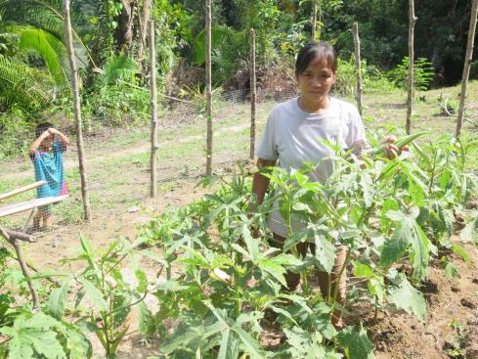
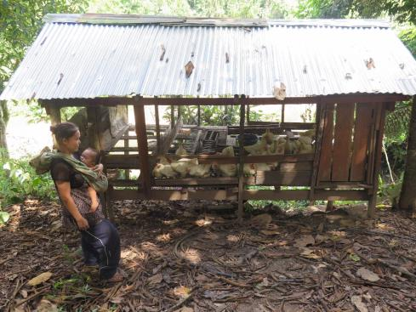
OUTPUT 2: CAPACITY OF THE COMMUNITY ON DEVELOPMENT ENHANCED
Activity 2.1 Alternative Livelihood Activities
Vegetable & Chicken Farming Activities at Project Site

Slide 22
OUTPUT 2: CAPACITY OF THE COMMUNITY ON DEVELOPMENT ENHANCED
Activity 2.2 Infrastructure Improvement Contributing to SFM
Discussion with NCR land owners have been successful for construction of road from Long Napir to Kampung Bahagia
Preparation for gravelling of road (part) such as acquiring stones from supplier and manpower has been arranged
Construction site for building Multi-Purpose Hall has been identified
Achievement

Slide 23
OUTPUT 2: CAPACITY OF THE COMMUNITY ON DEVELOPMENT ENHANCED
Activity 2.2 Infrastructure Improvement Contributing to SFM
Core materials for renovations of Guest House and manpower has been acquired
Successful installation of solar energy power system at households of both villages
Achievement

Slide 24
OUTPUT 2: CAPACITY OF THE COMMUNITY ON DEVELOPMENT ENHANCED
Activity 2.2 Infrastructure Improvement Contributing to SFM
Household have access to electricity from installed solar power system that is beneficial when doing daily chores
The local community at both villages are active in acquiring materials for construction of roads and Guest House, which increased their household income
Impacts

Slide 25
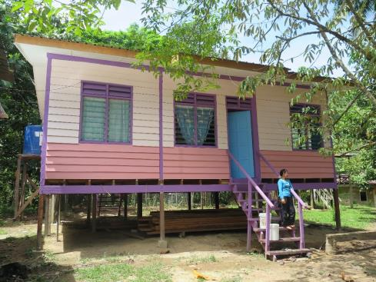
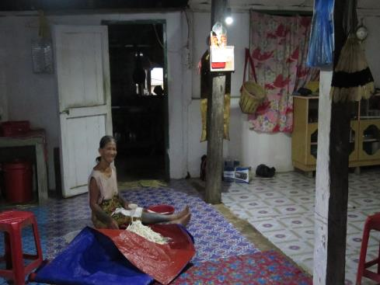
OUTPUT 2: CAPACITY OF THE COMMUNITY ON DEVELOPMENT ENHANCED
Activity 2.2 Infrastructure Improvement Contributing to SFM
Homestay at Kampung Bahagia
Solar Powered Lights at Long Napir

Slide 26
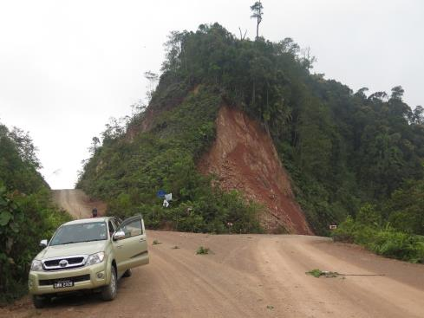
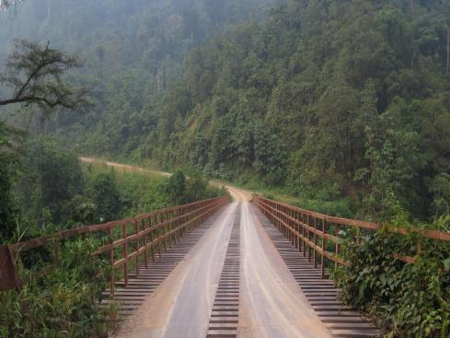
VARIOUS PICTURES FROM PROJECT SITE
Ascending dirt road leading to
Long Napir (Left)
Steel bridge leading to Long Napir

Slide 27
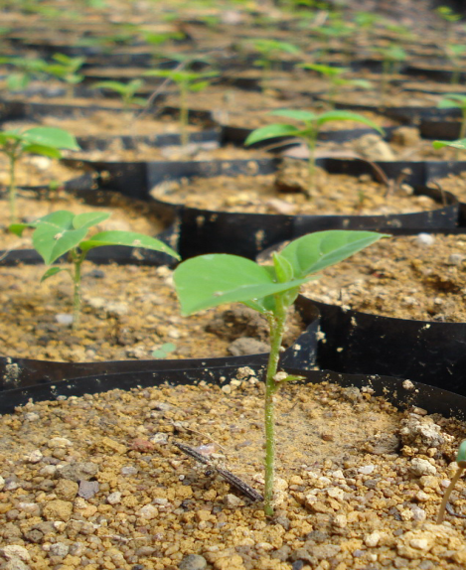
Conclusion and Ways Forward
APFnet project in Sarawak :
The progress achieved for the reporting period are encouraging and as expected despite a delay of some activities
A source of inspiration for policy and decision makers in Sarawak . The Sarawak Forest Department, the project team and concerned communities have established a good working relationship in the implementation of various activities
Effective implementation of the project: Efforts will be made for regular monitoring systems; Community-based management with forest management maps, regulations and committees.
Sustainable capacity building: Considerable time is needed to build capacity of the two indigenous local communities to use participatory approaches in watershed management; longer term approach to achieve more consistent and replicable results.
Thank you for your attention

Slide 28
Conclusion and Ways Forward
APFnet project in Sarawak :
The progress achieved for the reporting period are encouraging and as expected despite a delay of some activities
A source of inspiration for policy and decision makers in Sarawak . The Sarawak Forest Department, the project team and concerned communities have established a good working relationship in the implementation of various activities
Effective implementation of the project: Efforts will be made for regular monitoring systems; Community-based management with forest management maps, regulations and committees.
Sustainable capacity building: Considerable time is needed to build capacity of the two indigenous local communities to use participatory approaches in watershed management; longer term approach to achieve more consistent and replicable results.
Thank you for your attention

Slide 29
Conclusion and Ways Forward
APFnet project in Sarawak :
The progress achieved for the reporting period are encouraging and as expected despite a delay of some activities
A source of inspiration for policy and decision makers in Sarawak . The Sarawak Forest Department, the project team and concerned communities have established a good working relationship in the implementation of various activities
Effective implementation of the project: Efforts will be made for regular monitoring systems; Community-based management with forest management maps, regulations and committees.
Sustainable capacity building: Considerable time is needed to build capacity of the two indigenous local communities to use participatory approaches in watershed management; longer term approach to achieve more consistent and replicable results.
Thank you for your attention

